Slide 1
Lecture 12 Program for Self-regulation and Health

Slide 2
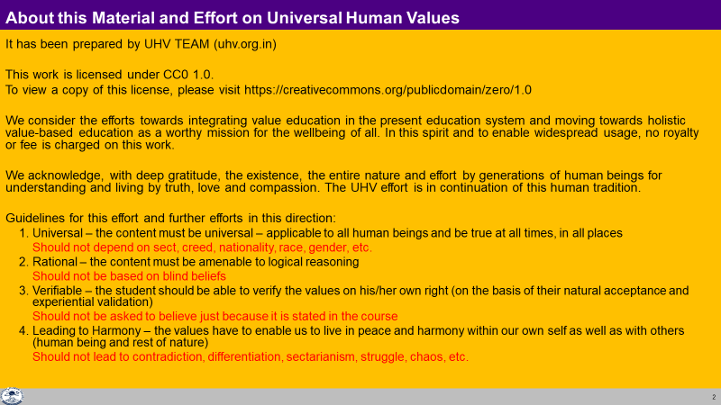

Slide 3
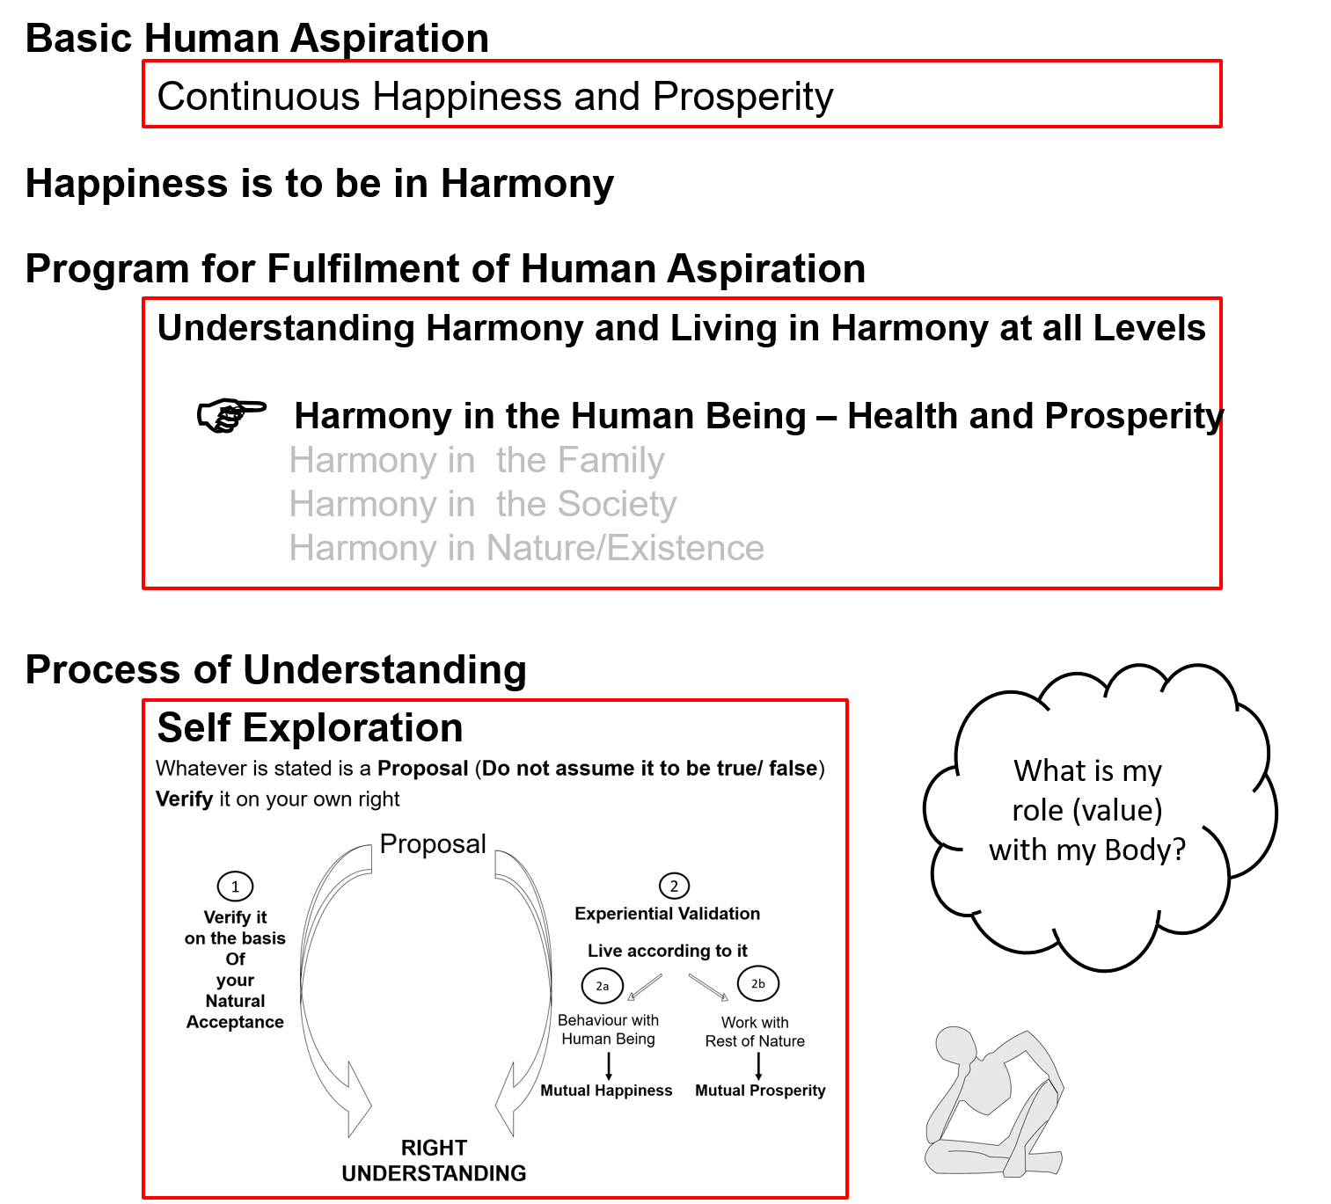
Notes:
Health → Self regulation and health

Slide 4
Human Being Ekkuo | Self eSa | Body “kjhj
Need vko';drk | Happiness (e.g. Respect) lq[k ¼tSls lEeku½ | Physical Facility (e.g. Food) lqfo/kk ¼tSls Hkkstu½
In Time dky esa | Continuous fujUrj | Temporary lkef;d
In Quantity ek=k esa | Qualitative (is Feeling) xq.kkRed ¼Hkko gS½ | Quantitative (Required in Limited Quantity) Ekk=kRed ¼lhfer ek=k esa½
Fulfilled By iwfrZ ds fy, | Right Understanding & Right Feeling lgh le>] lgh Hkko | Physio-chemical Things HkkSfrd&jklk;fud oLrq
Activity fØ;k | Desire, Thought, Expectation… bPNk] fopkj] vk”kk--- | Eating, Walking… [kkuk] pyuk---
In Time dky esa | Continuous fujUrj | Temporary lkef;d
Response | Knowing, Assuming, Recognising, Fulfilling tkuuk] ekuuk] igpkuuk] fuokZg djuk | Recognising, Fulfilling igpkuuk] fuokZg djuk
 | Consciousness pSrU; | Material tM+
Co-existence
lgvfLrRo

Slide 5
Human Being Ekkuo | Self (I) eSa | Body “kjhj
Need vko';drk | Happiness (e.g. Respect) lq[k ¼tSls lEeku½ | Physical Facility (e.g. Food) lqfo/kk ¼tSls Hkkstu½
Fulfilled By iwfrZ ds fy, | Right Understanding & Right Feeling lgh le>] lgh Hkko | Physio-chemical Things HkkSfrd&jklk;fud oLrq
 | Feeling of Self-regulation (संयम) | Health (स्वास्थ्य)
 | Feeling of responsibility toward the body – for Nurturing, Protection and Right Utilization of the Body | The Body acts according to the Self Parts of the body are in harmony (in order)
Co-existence
lgvfLrRo
The Body is an orderly system (a harmony). It has definite conduct
The cells in the body work together, in harmony with each other, participate in the larger order to form tissues, organs and organ systems…
With a feeling of self-regulation (responsibility towards the body), I (Self) naturally make effort to ensure the continuity of harmony in the Body (at least I do not disturb it)
Health in the Body is a natural outcome of the feeling of self-regulation in the Self
Notes:
Who is the observer? Self or body?
Can you see that you are always active “imagination” is always going on

Slide 6
Program
(A) For Staying Healthy
1 Intake and Routine (Lifestyle)
2 Labour and Exercise
3 Postures for regulating internal & external body organs and
Regulated Breathing
4 Medicine and Treatment
Note: This is a program for health, not the only program for health
(B) For bringing body back to harmony from temporary disharmony
(C) Dependence on drug / machine to perform a body function

Slide 7
Intake
Intake includes all that we take ingest – food, water, air, sunlight…
To maintain health:
Intake of food that is nutritious, digestible, tasty and the waste is excretable
Intake of water in the right amount and at the right time
Daily exposure to fresh air and sunlight…

Slide 8
Routine
The Circadian Rhythm
Body response to the solar cycle
(Understanding this helps in setting up a harmonious daily routine)
The Rhythm of Seasons
Body response to the seasons
Availability of complementary plants in various seasons
(Understanding this helps in deciding appropriate seasonal intake, necessary protection of the Body and setting up a harmonious seasonal routine)
The Body lifecycle Rhythm
Childhood – growth (cuf)
Youth (pitta)
Old age (vata)
(Understanding this helps in deciding a harmonious lifestyle for each stage of life)

Slide 9
Understanding the Circadian Rhythm can help us setup a Harmonious Daily Routine
Cleansing time
6 AM
Wake-up time
(~1½ hrs before sunrise)
Breakfast time
Waste Removal
(Detoxification through Kidneys…)
Air–Space (Vata) time
Earth–Water (Kapha) time
2 AM
10 AM
Regeneration and Repair
(Liver Activation…)
Deep Sleep
Fire–Water (Pitta) time
Fire–Water (Pitta) time
Lunch time
12 Midnight
12 Noon
Maximum Agni (Digestive Fire)
Bed time
10 PM
Earth–Water (Kapha) time
Air–Space (Vata) time
2 PM
Absorption and
Assimilation
Dinner time
6 PM

Slide 10
Labour Exercise
Ensure adequate movement of the Body + production of physical facility
Examples:
Sweeping and swabbing your room / house / hostel
Kitchen gardening
Cycling to your college and back…
Ensure adequate movement of the Body
Examples:
Jogging outdoors
Weight training in a gym
Exercise cycling in a gym
Recreational cycling outdoors

Slide 11
Postures Breathing
Postures for regulating internal and external body organs
Example: Yoga
Regulated Breathing
Example: Pranayam

Slide 12
Medicine
Treatment
For bringing body back to harmony from temporary disharmony
Examples:
Home remedies
Integrated systems of medicine
Using a drug / machine to perform a body function that the body is no longer able to perform (dependence)
Examples:
Insulin
Dialysis
Ventilator

Slide 13
Program – Priority
(A) For Staying Healthy
1a
1 Intake and Routine (Lifestyle)
2 Labour and Exercise
3 Postures for regulating internal & external body organs and
Regulated Breathing
4 Medicine and Treatment
1
1b
2
(B) For bringing body back to harmony from temporary disharmony
3
(C) Dependence on drug / machine to perform a body function

Slide 14
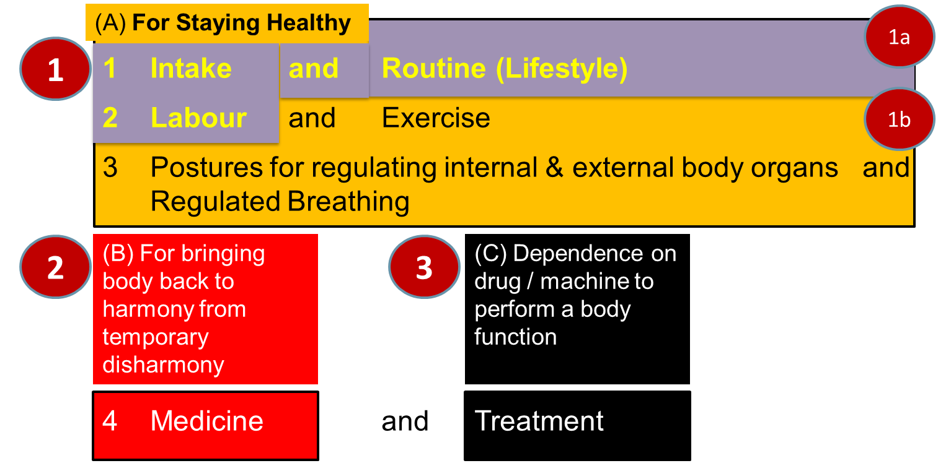
Sum Up
The Self and the Body are in Harmony when there is a feeling of Self-regulation in the Self and Health in the Body
Self-regulation = Feeling of responsibility toward the body – for Nurturing, Protection and Right Utilization of the Body
Health = The body acts according to Self and parts of the body are in harmony (in order)
Program

Slide 15
Self Reflection

Slide 16
Practice Session
In the last 3 years, recall the times that your body has been ill (in disharmony). What steps were taken to restore the harmony of the Body?
What kind of daily schedule would you have with a strong feeling of self-regulation?
Approximately how much time would you allocate for keeping your body in good health through:
Healthy intake (food, air, water, sunlight, etc.)
Timings for upkeep of the Body (sleeping and waking up time, excretion, bathing, etc.)
Labour (production of physical facility)
Exercise
Balancing internal and external organs of body
Regulating breathing of body
(Of course, you need to keep adequate time for studying, understanding, learning, behaviour, work etc.)
Do you think this schedule will make you more productive or less productive? What conclusions do you draw from this exercise?
Date(s) | Illness or disharmony | Type (Accident, viral infection, bacterial infection, lifestyle related disorder, any other) | Steps taken | Root Cause

Slide 17
Key Points
Programme to ensure self-regulation and Health

Slide 18
Notes:
Health → Self regulation and health

Slide 19
Human Being Ekkuo | Self eSa | Body “kjhj
Need vko';drk | Happiness (e.g. Respect) lq[k ¼tSls lEeku½ | Physical Facility (e.g. Food) lqfo/kk ¼tSls Hkkstu½
In Time dky esa | Continuous fujUrj | Temporary lkef;d
In Quantity ek=k esa | Qualitative (is Feeling) xq.kkRed ¼Hkko gS½ | Quantitative (Required in Limited Quantity) Ekk=kRed ¼lhfer ek=k esa½
Fulfilled By iwfrZ ds fy, | Right Understanding & Right Feeling lgh le>] lgh Hkko | Physio-chemical Things HkkSfrd&jklk;fud oLrq
Activity fØ;k | Desire, Thought, Expectation… bPNk] fopkj] vk”kk--- | Eating, Walking… [kkuk] pyuk---
In Time dky esa | Continuous fujUrj | Temporary lkef;d
Response | Knowing, Assuming, Recognising, Fulfilling tkuuk] ekuuk] igpkuuk] fuokZg djuk | Recognising, Fulfilling igpkuuk] fuokZg djuk
 | Consciousness pSrU; | Material tM+
Co-existence
lgvfLrRo

Slide 20
Human Being Ekkuo | Self (I) eSa | Body “kjhj
Need vko';drk | Happiness (e.g. Respect) lq[k ¼tSls lEeku½ | Physical Facility (e.g. Food) lqfo/kk ¼tSls Hkkstu½
Fulfilled By iwfrZ ds fy, | Right Understanding & Right Feeling lgh le>] lgh Hkko | Physio-chemical Things HkkSfrd&jklk;fud oLrq
 | Feeling of Self-regulation (संयम) | Health
 | Feeling of responsibility toward the body – for Nurturing, Protection and Right Utilization of the Body | The Body acts according to the Self Parts of the body are in harmony (in order)
Co-existence
lgvfLrRo
Notes:
Who is the observer? Self or body?
Can you see that you are always active “imagination” is always going on

Slide 21
Program – Priority
(A) For Staying Healthy
1a
1 Intake and Routine (Lifestyle)
2 Labour and Exercise
3 Postures for regulating internal & external body organs and
Regulated Breathing
4 Medicine and Treatment
1
1b
2
(B) For bringing body back to harmony from temporary disharmony
3
(C) Dependence on drug / machine to perform a body function
1a. Intake includes air, water, sunlight, food (food is nutritious, digestible & tasty and waste is excretable), all intake through our senses (sound, sight, smell etc)
1b. Rising time, sleeping time, eating time…
2a. Outcome of labour is production of physical facility
2b. No physical facility is produced by exercise

Slide 22
FAQs for Lecture 12
Programme to ensure self-regulation and Health

Slide 23
Question(s): Response
Is self-regulation same as self control or self restraint?
Self-regulation is defined as- Feeling of responsibility toward the body – for Nurturing, Protection and Right Utilization of the Body.
With this feeling of responsibility, the self takes care of the body.
When we talk about self control or self restraint, the sense we get is that the self is controlling things related to body with a feeling of fear or of opposition.
For example, with feeling of responsibility, I eat food which is nutritious and tasty, but, I don’t eat food which is tasty but, not nutritious. This happens in a natural manner. On the other hand, if I don’t have this feeling of responsibility, and I want to eat food which is tasty but not nutritious, however, due to fear of falling sick, I am not eating that food, then, this is self restraining. This doesn’t happens in a natural manner and somewhere I have a feeling of unhappiness.

Slide 24
Question(s): Response
The body has an ageing process and with age diseases start appearing. Also there are viruses etc. Will a person with right understanding and feeling of self-regulation not have such diseases?
Is health of body also a human value?
In general, a person with right understanding and feeling of self-regulation will be able to maintain the health of his body and not fall sick. However, the aging of the body will certainly have its effect, but, he will be able to see this and plan his lifestyle accordingly. Similarly, tmhe effect of environment such as extreme weather or even viruses can effect the health of his body. But,, he will handle this by taking preventive measures or by doing the necessary detoxification or taking the suitable medicine, so that the body can recover its health.
Feeling of Self-regulation is value in the self, which expresses itself as health in the body. This can be seen as the feeling of care towards the body.

Slide 25
Question(s): Response
What would be right utilisation of a healthy Body?
The Self is central to human existence
The purpose Self is to develop completeness of
Right understanding, i.e. understanding of harmony at all levels of being – Truth
Right feeling, i.e. feeling of harmony – Love
Right thought, i.e. thought of how to live in harmony – Compassion
The Body is used as an instrument by the Self for interacting with the world outside:
Behaviour with human being
Work with rest of nature
Physical facility is required for the Body – to nurture it, protect it and in the process of right utilisation of the Body

Slide 26
Question(s): Response
If body is unhealthy, will the Self be still happy?
How do you distinguish between mental health and physical health?
As we have discussed, happiness in the self can be unsured through right understanding and right feelings which has to do with the state of the self and not state of the body. However, if the body is unhealthy, it will be a matter of concern, and the person with right understanding will do whatever is necessary for recovering the health of the body, without getting unhappy over it.
Mental health has to with disharmony at the level of self, but, Physical health has to with disharmony at the level of Physical body.

Slide 27
Question(s): Response
Why is medicine and treatment kept separate – aren’t they similar?
As discussed in the session,
medicine is used-r bringing body back to ary For bringing body back to harmony from temporary disharmony
this can be done through Home remedies or through Integrated systems of medicine
However, Treatment has to do with
Using a drug / machine to perform a body function (dependence)
For examples, by using Insulin in case of diabetes or doing Dialysis for blood purification.

Slide 28
Question(s): Response
What will be the role of a doctor if everyone has the feeling of self-regulation?
The major role of the doctors then would be
Health education- education that will enable people to have this feeling of self-regulation and develop the competence to take care of the health of their body
To help them to take preventive measures for the effect of the environment
Provide them necessary help to recover if their body falls sick due to the effect of the environment through
detoxification or
medicine
Provide treatment, only in extreme cases when there is no option to take any other recourse

Slide 29
Question(s): Response
Like this doctors will become unemployed… What about their income? Today health-care is a thriving multi billion dollar industry employing millions of people! What will happen to all that?
Check what is naturally acceptable:
A system that ensures health
A system based on illness
So, we have to make effort for that kind of system. Ultimately, a system for the wellbeing of all (what NEP2020 calls and equitable and just society). People with a holistic world-view, competence and commitment may be able to work towards such a society. We will discuss this when we cover harmony in society

Slide 30
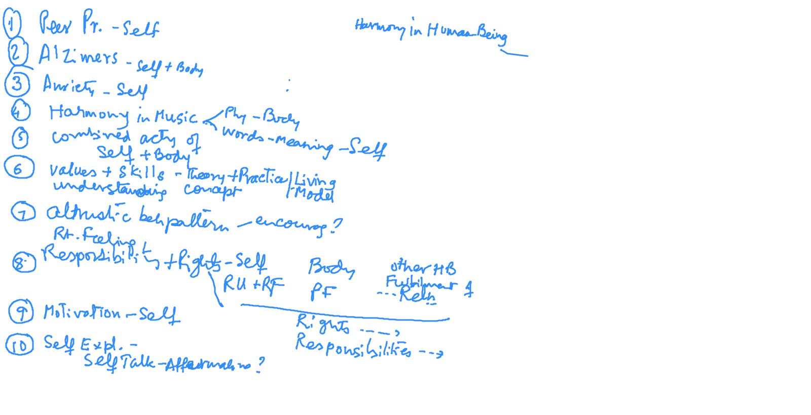
Q&A at end of Module 1 & 2 [22-01-2021]

Slide 31
Nurturing the Body – e.g., Food
Purpose of food: To nurture the body
Check re. my choice of food
Is the food nutritious?
Is it digestible?
Is it tasty?
Is the waste excretable?
Am I trying to fetch happiness from the taste?
Am I choosing food to get acceptance, respect?

Slide 32
Protection of the Body – e.g., Clothes
Purpose of clothes: To protect the body
Check re. my choice of clothes
1. Are my clothes appropriate for the season?
2. Am I trying to get respect from others on the basis of clothes?
Check re. how the other may be influenced by the way I dress
1. Are my clothes socially appropriate, acceptable?
2. Do my clothes help others to see me as similar to them?
3. Are my clothes creating jealousy, envy in other?
4. Do my clothes arouse feeling of lust in other?
5. Does my choice of clothes promote or compromise social justice?
6. Does my choice of clothes promote or harm harmony in Nature?

Slide 33
Right Utilisation of the Body
Purpose of body: To facilitate me in fulfilling my basic aspiration
Check how I use the body
Do I use the body to receive proposals for my self-development?
Do I use the body to share proposals for the self-development of others?
Do I use the body to produce required physical facility?
Do I use the body to enrich, protect the rest of nature?
Do I use the body for getting favourable sensation (which I have assumed to be happiness)?

